Slide 1

The GenericSuite Software Library
Exploring the Significance of Generic Programming for Innovation in Software Development
https://genericsuite.carlosjramirez.com

Slide 2



Presentation
Carlos J. Ramírez
Computing Science Diploma, IUNP, Caracas, 1987. Started Computer Science Bachelor's Degree, Universidad Alejandro Humbold, Caracas, 2004. Software Engineer @ SourceMeridian. 37+ years of experience in Software Development.

Slide 3


Content
Preamble
Motivation, why was it created?
Generic Programming
Origin of GenericSuite
Evolution
What does GenericSuite offer?
How does GenericSuite work?
Key functionalities showcase
Tools used
Commitment
Conclusions / Q&A

Slide 4
Preamble
GenericSuite was designed to streamline Apps development.
Tools to facilitate APIs and UI development.
Utilities to facilitate tasks in the software development life cycle (SDLC).
Software development constantly face efficiency and code reuse challenges.
Add AI and RAG* to Apps.
Framework allows to focus on business logic.
(*) Retrieval Augmented Generation

Slide 5

Motivation: Why GenericSuite was created?
Have you ever had to copy and paste code from one application to another?
Initially created to avoid code redundancy in my own projects.
Gain professional experience in Python and React.js.
Experience the NPMJS and PyPi libraries creation.
Accelerate application development.

Slide 6

What’s Generic Programming?
Generic Programming = make the code parameterizable and reusable.
Apply DRY principle (Don't Repeat Yourself): minimize redundancy.
Avoid WET principle (Write Everything Twice): e.g. copy and paste code.
These principles facilitate more efficient and maintainable software development.

Slide 7
GenericSuite Origin
Mid-80s: first contact with the generic CRUD editor concept and other elements generated with generic programming from structured configurations (menu, security, reports).
I worked in a company that handled these concepts using the trendy languages and databases of the time (Clipper and dBase III), with the configurations stored in the database and generated by a home-made program.
In my opinion, this concept was way ahead of its time.

Slide 8
GenericSuite Origin (2)
1999 > 2000: I made a generic CRUD editor with Microsoft ASP (Active Server Pages) for a CMS like WordPress, with the data entry form definitions in the Database.
2020: during the pandemic, I created new App called FynApp, and started the generic CRUD editor development in React.js, with the "hard coded" configuration structures in the code.

Slide 9

Evolution
The emergence of ChatGPT at the end of 2022 and the whole AI boom made me very curious and eager to include some of that in FynApp.
During PyCon Colombia in June 2023, I came up with the idea of bringing generic programming to the Backend.

Slide 10
Evolution (2)
June 2023: development of generic Backend modules to handle CRUD, automatic generation of Endpoints and Menus with the same Frontend configurations, using JSON files stored in a common repository.
July 2023: I participated in the Google Vertex AI Hackathon in Lablab.ai and that gave me the ideas to create FynBot: the artificial intelligence assistant for FynApp, based on the OpenAI APIs and GPT Functions.

Slide 11
Evolution (3)
August > November 2023: Image Generation (Dall-E), Audio (TTS), Image Recognition (Vision).
Deployment with AWS SAM (Serverless Application Model).
December 2023: Implementation of LangChain to use any LLM/NLP/Embeddings model and not being tied to a single provider.
Local DNS and access to the development environment with HTTPS.
January 2024: Google Gemini and Hugging Face are included in the model offering.

Slide 12
Evolution (4)
February 2024: Extraction of generic programming from FynApp. GenericSuite was born.
The first version was published at the beginning of March 2024 and the functional libraries were published in NPMJS and PyPi in April 2024.
This is the first formal contribution I've made to the Open-Source community.

Slide 13
What does GenericSuite offer?
GenericSuite Core:
Frontend
Backend
Scripts
Extensions:
AI (RAG, LLM, NLP)
Barcode
Maps

Slide 14

Sheet
Backend: Python 3.9+
Frontend: React.js
Mobile: Flutter
IAC / Platform: AWS
AI: OpenAI GPT, Google Gemini, Anthropic Claude, Hugging Face Models (anyone with conversational capability), Clarifai.
Operating System: Linux (servers, development) / MacOS (development).

Slide 15
GenericSuite Core
Generic CRUD editor: create-read-update-delete code that can be parameterized and extended. There's no need to rewrite every table editor.
Menu Builder: to configure the hierarchical structure, user security levels, and React.js components.
Endpoint Builder: To configure the entry points (URLs) of APIs and Python methods.
All configurations in JSON files.

Slide 16
GenericSuite Core (2)
Database Abstraction:
The backend can use either DynamoDB or MongoDB.
DynamoDB can be accessed using the same MongoDB syntax.
Framework Abstraction: for the development of APIs in Python with FastAPI, Chalice or Flask indistinctly.
Parameterization from the database: to expand the possibility of configuring the system dynamically.

Slide 17
GenericSuite Core - Scripts
Scripts to build local environment allows you to run the application on the development computer with HTTP/HTTPS connections, local DNS, and local MongoDB database.
Deployment scripts: facilitates the deployment of the application in the different environments: QA, Staging, Demo and Production.
Frontend: on S3 buckets with "Static website hosting" option.
Backend: using SAM, using API Gateway, Lambda Functions, CloudFormation, ECR (Elastic Container Registry), CloudWatch.
Domains: handled by AWS Route 53 and ACM (AWS Certificate Manager).

Slide 18
GenericSuite AI
Endpoint to implement NLP (Natural Language Processing) conversations using on OpenAI APIs or the LangChain Framework.
Management of OpenAI, Google Gemini, Anthropic, Ollama and Hugging Face models.
Computer Vision (OpenAI GPT-4o / GPT4 Vision, Google Gemini Vision, Clarifai Vision).

Slide 19
GenericSuite AI (2)
Speech-to-text (OpenAI Whisper, Clarifai Audio Models).
Text-to-speech (OpenAI TTS-1, Clarifai Audio Models).
Image Generator: OpenAI DALL-E 3, Google Gemini Image, Clarifai.
Vector Index: FAISS, Chroma, Clarifai, Vectara, Weaviate, MongoDBAtlasVectorSearch.
Embedding Engines: OpenAI, Hugging Face, Clarifai, Amazon Bedrock, Cohere y Ollama.

Slide 20
GenericSuite AI (2)
Web search tool for AI agents.
Web Scrapping tool and web page analysis.
Embeddings processors for JSON, PDF, Git, and YouTube.
Language translation tools for AI agents.
User plan, OpenAI API key, and model name attributes in the user profile, to allow free plan users to use their own OpenAI credits.

Slide 21

How does GenericSuite work?
As a library of reusable components and Frontend/Backend services that can be easily integrated into any React.js and Python project.
It offers specific tools for the implementation of AI functionalities, such as natural language processing and data analysis, simplifying the incorporation of these advanced technologies into your applications.
Open-Source libraries in NPMJS and PyPi registries.

Slide 22
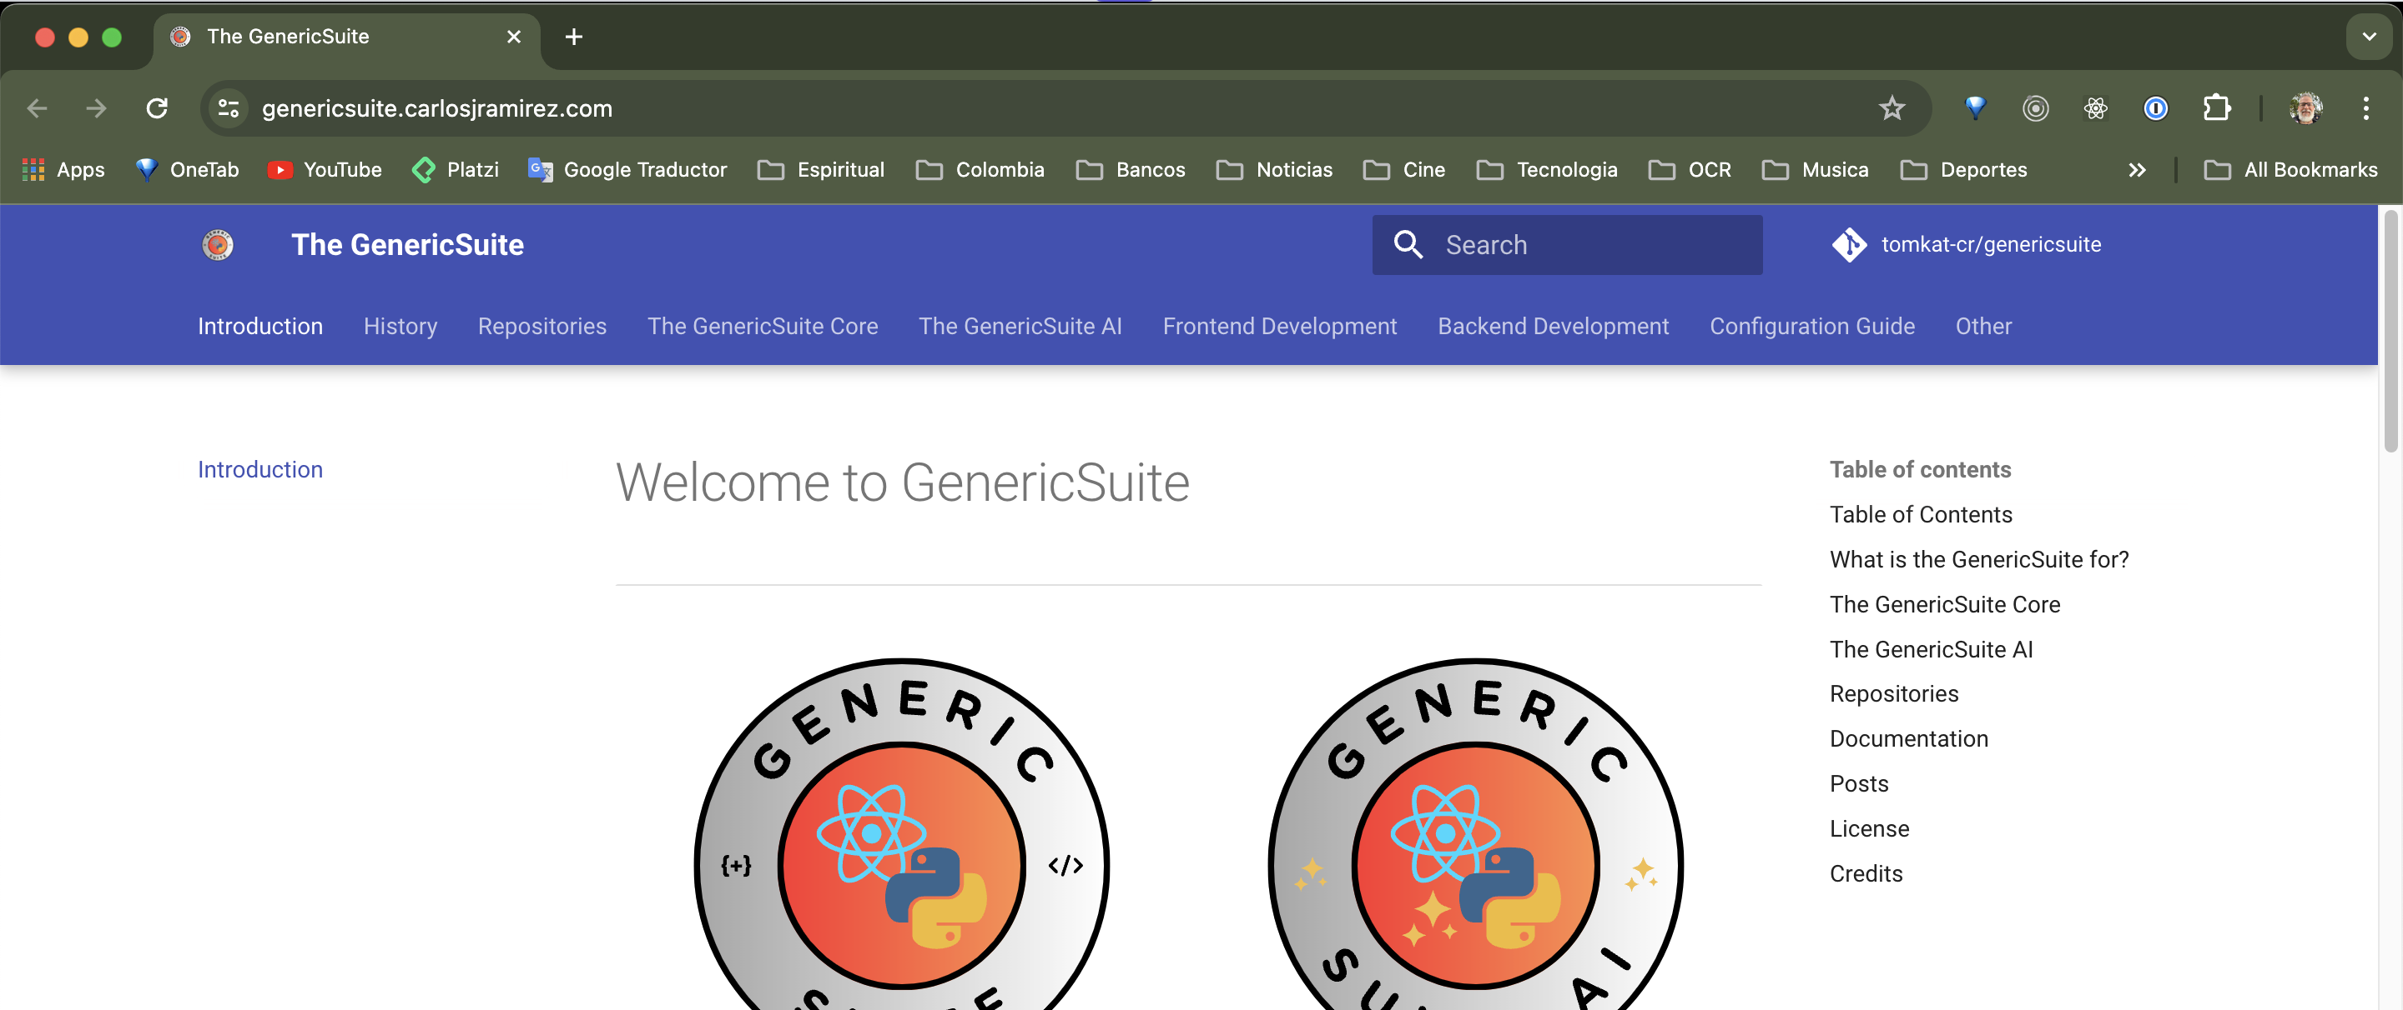
Documentation
https://genericsuite.carlosjramirez.com/

Slide 23

Key functionalities showcase
Practical examples:
How GenericSuite can be used to create personalized recommendations in a Calorie Deficit App.
Automate tasks using AI Bots.
Improve the user experience.

Slide 24
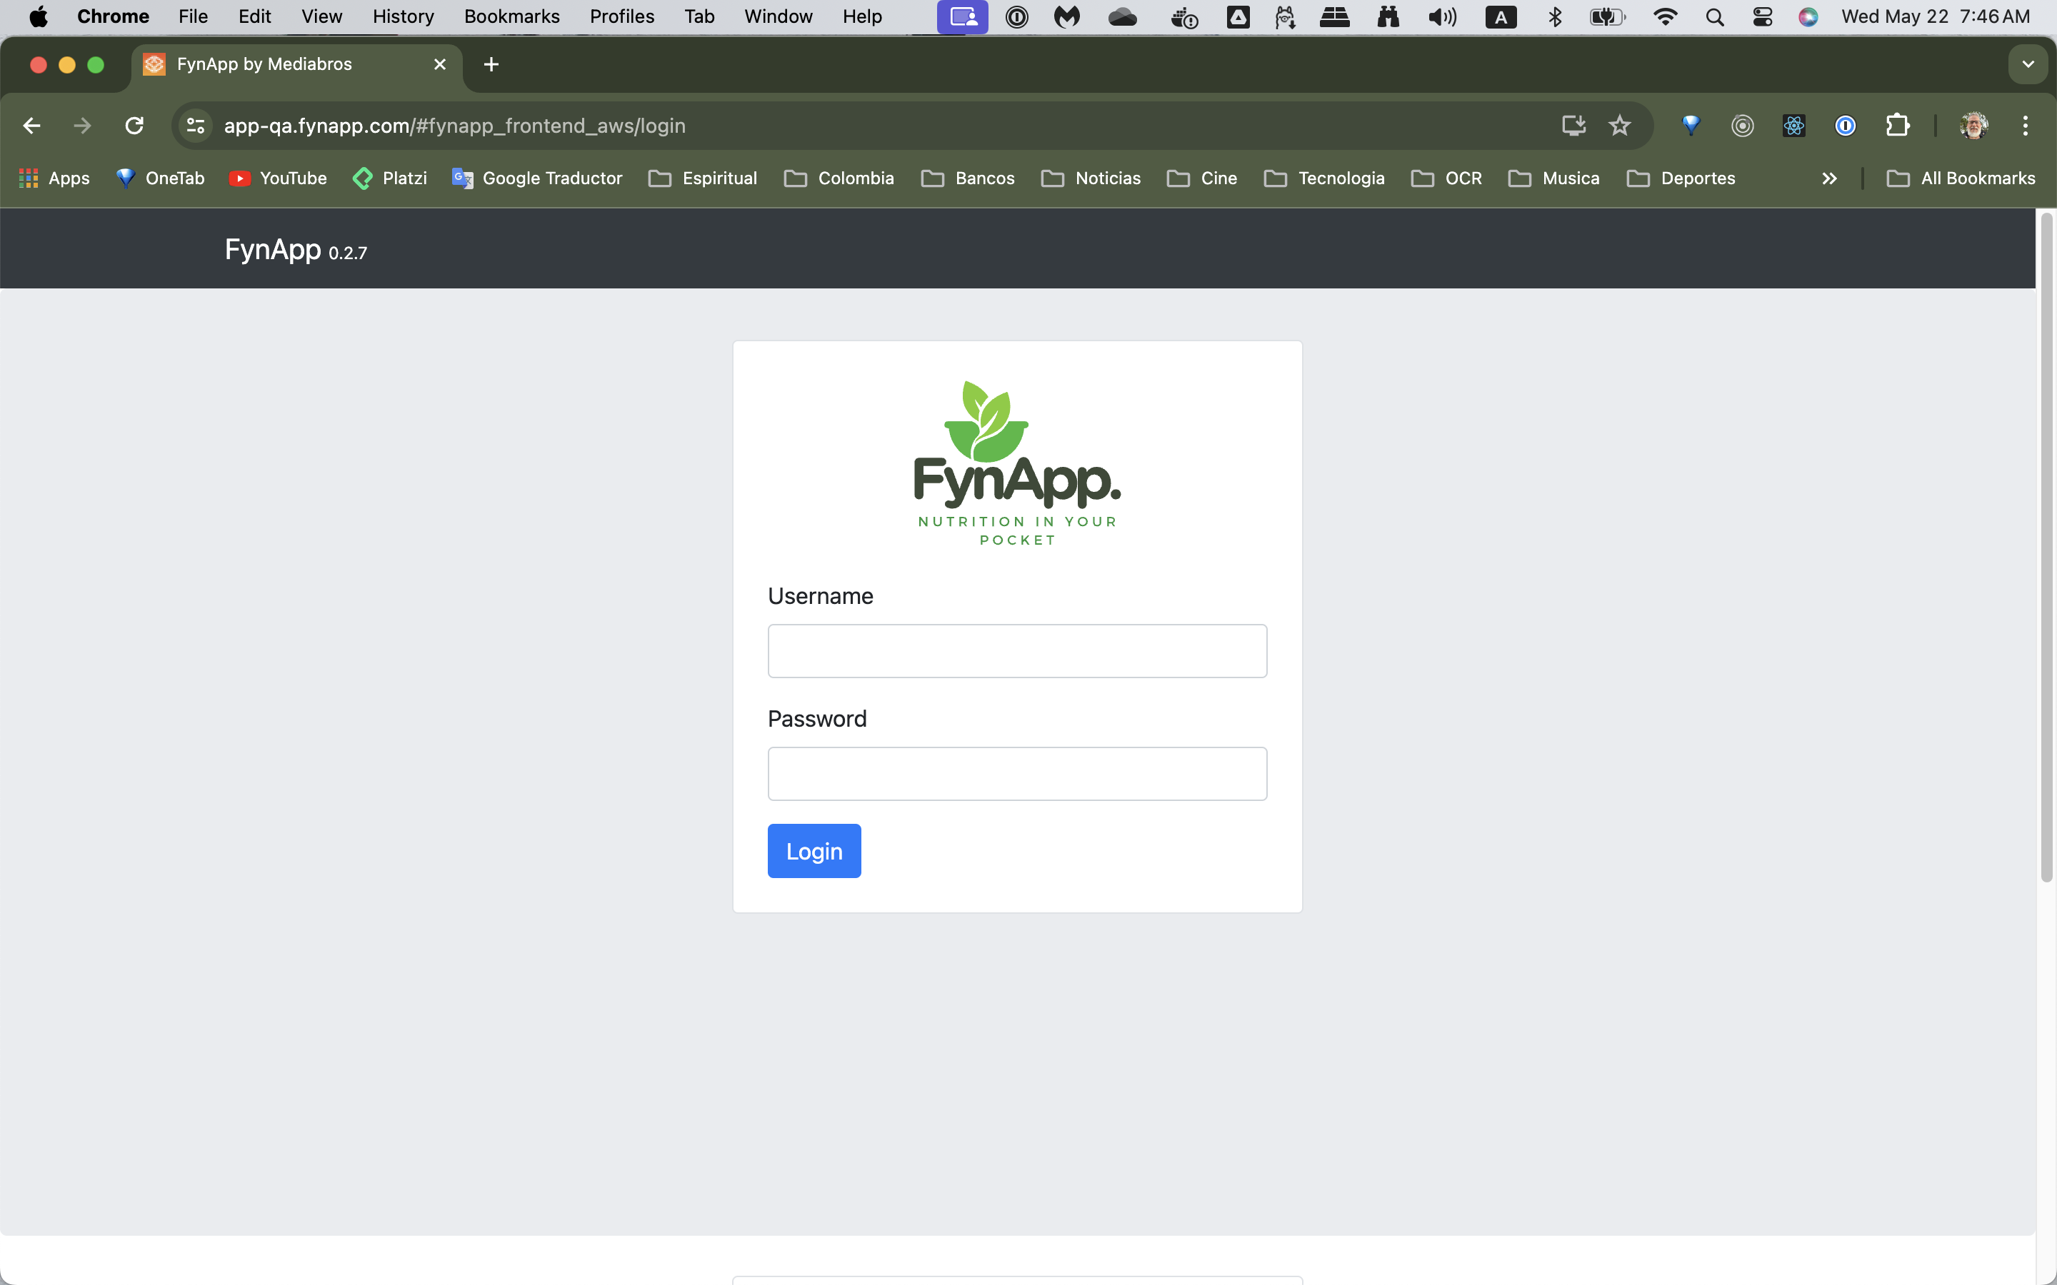
[ Custom Login ]

Slide 25
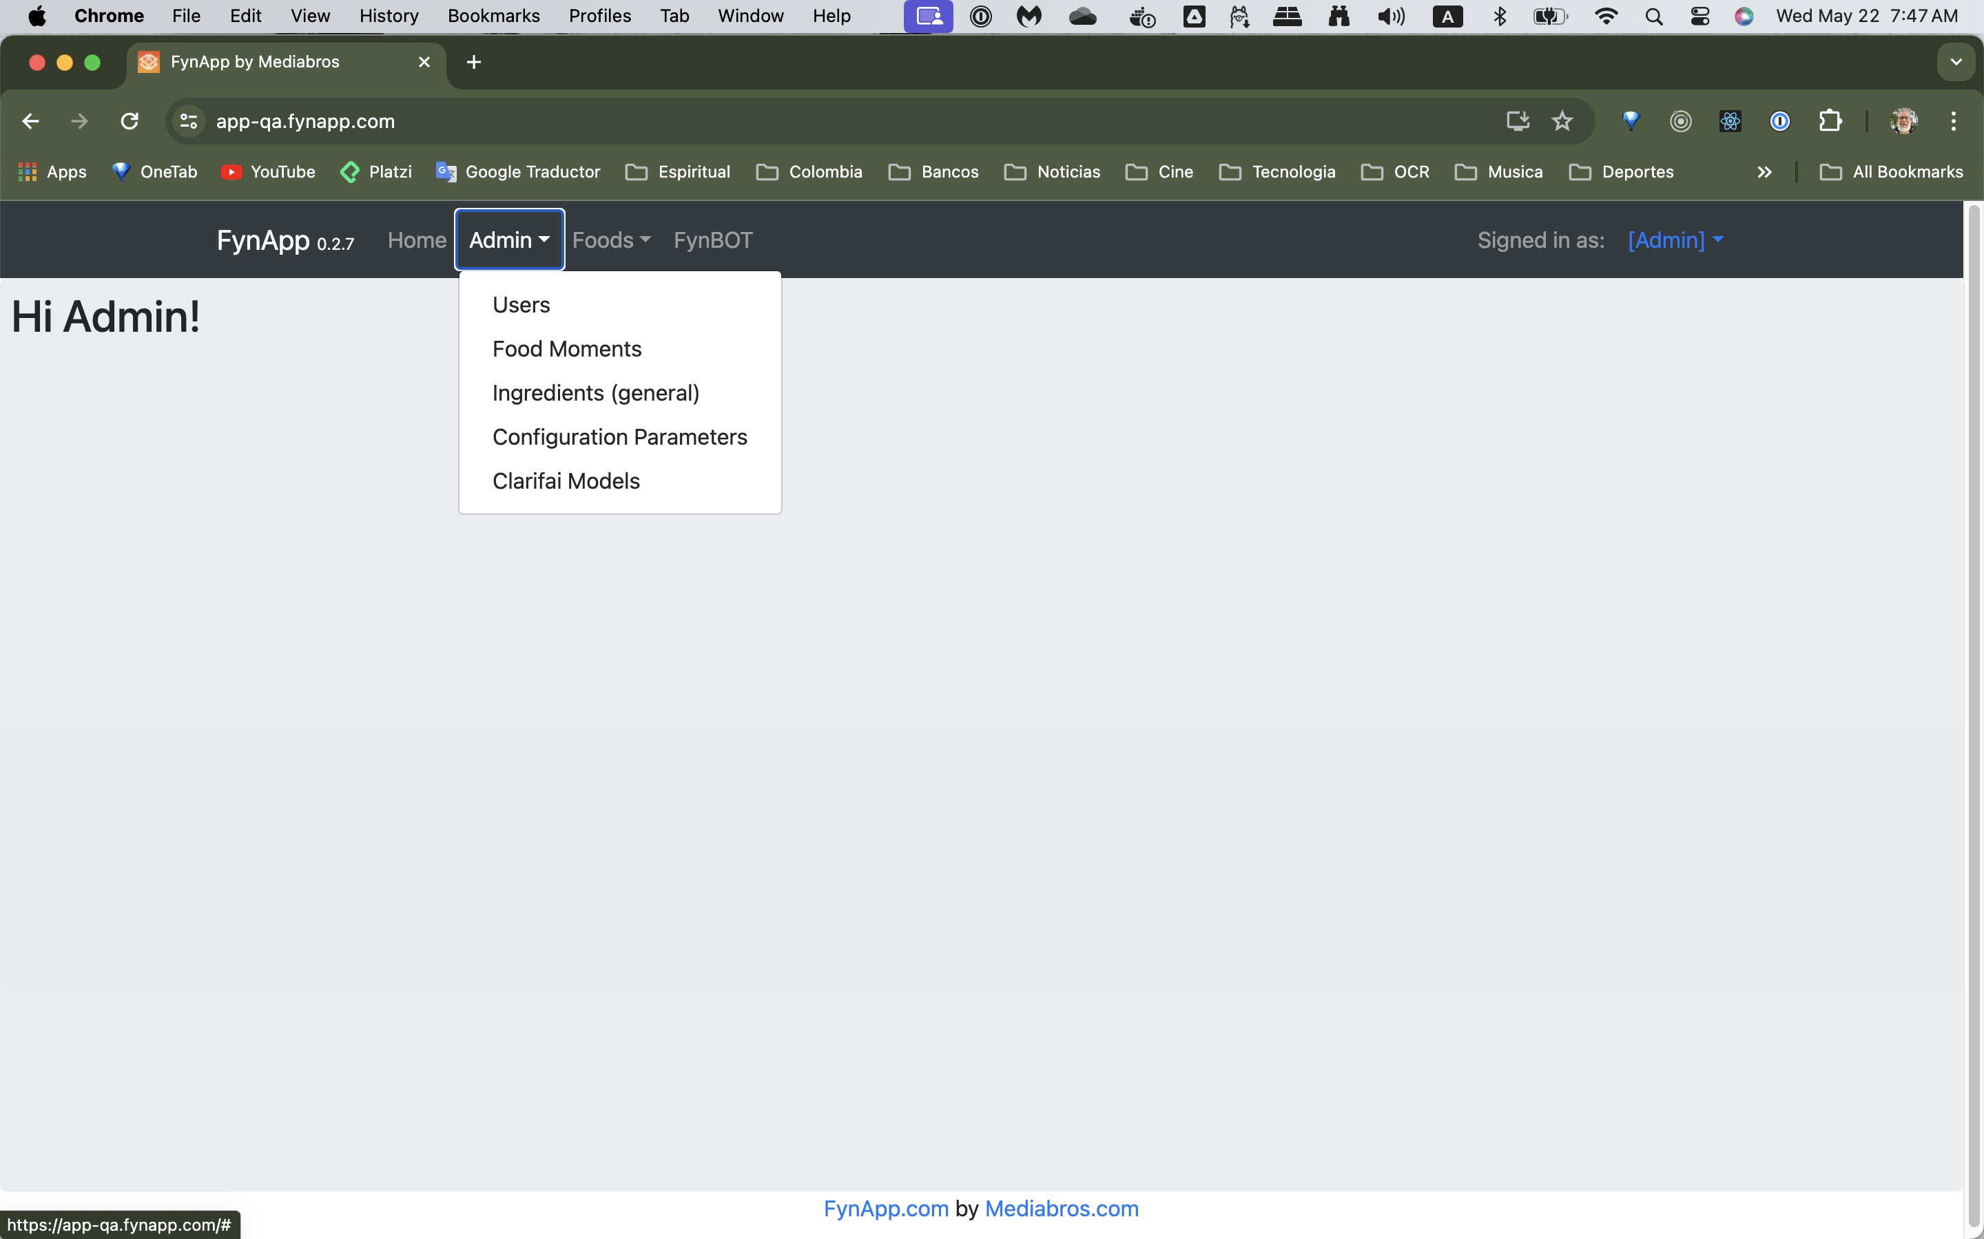
[ Home Page - Admin User ]

Slide 26
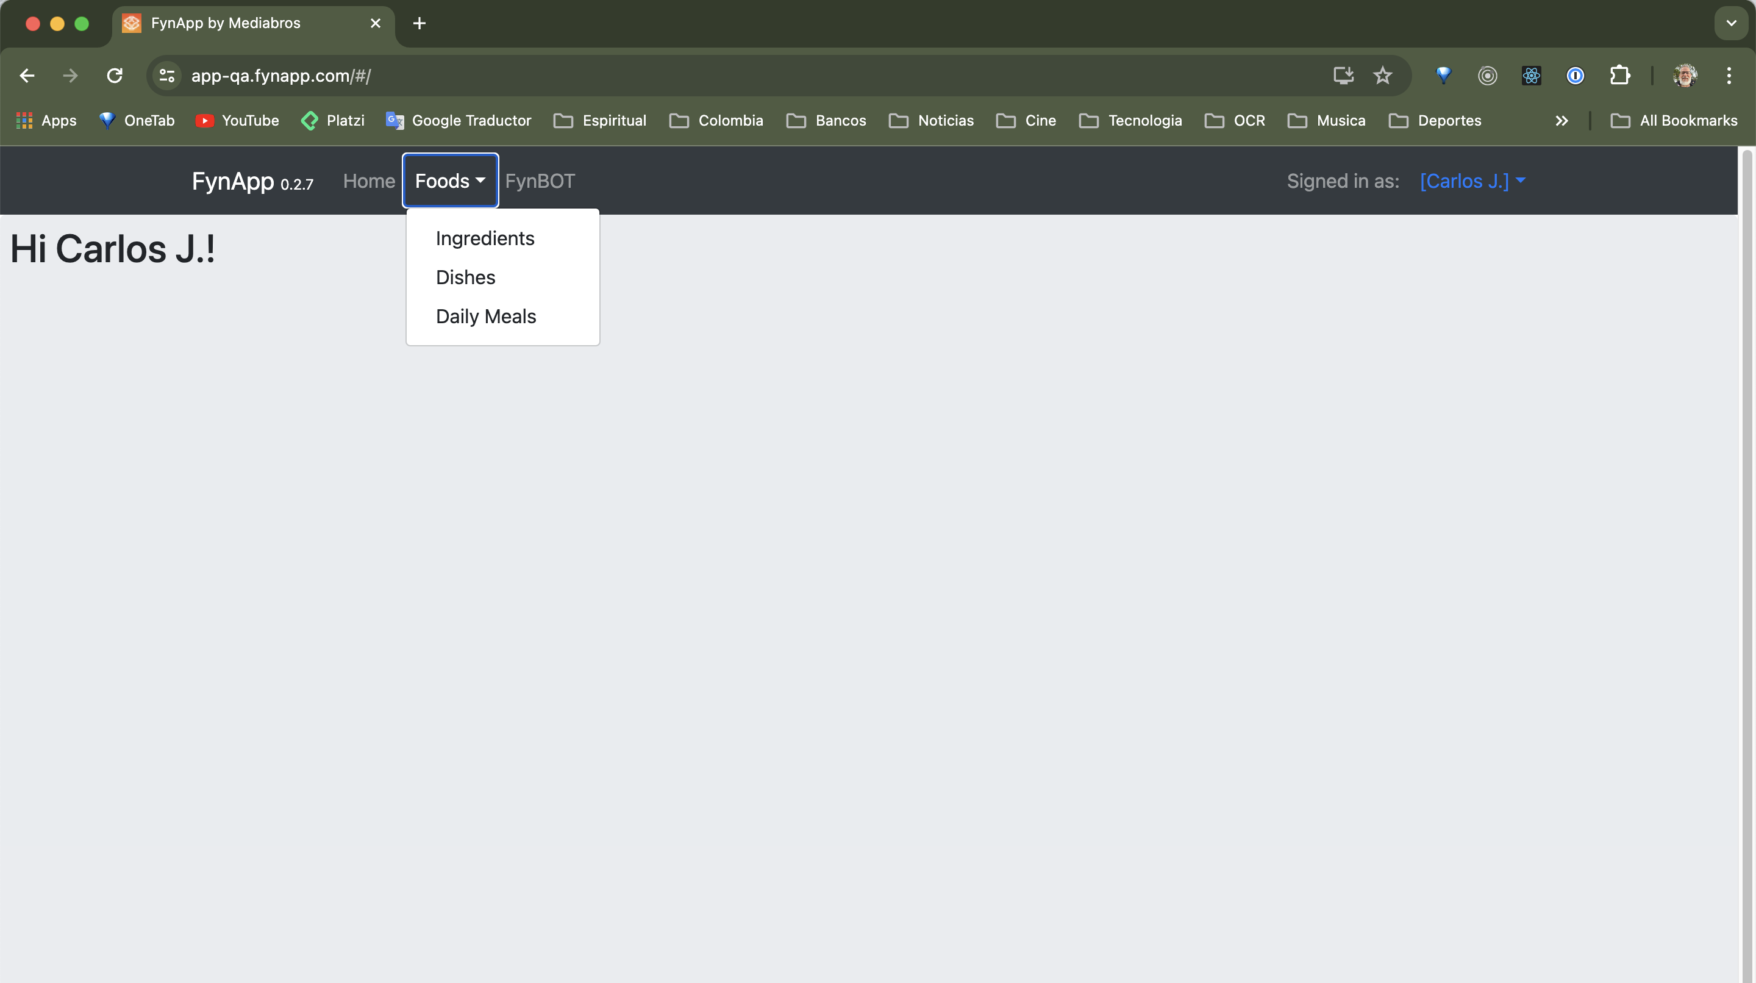
[ Home Page – Non-admin User ]

Slide 27
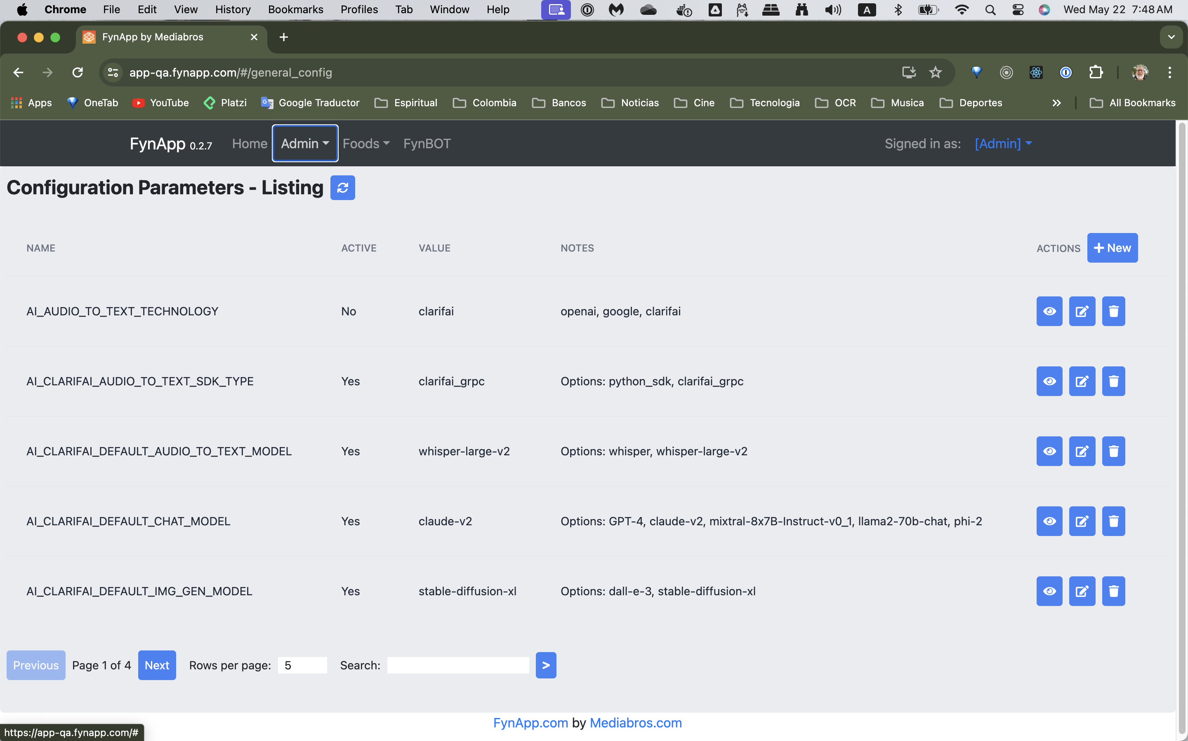
[ CRUD Editor - General Parameters ]

Slide 28
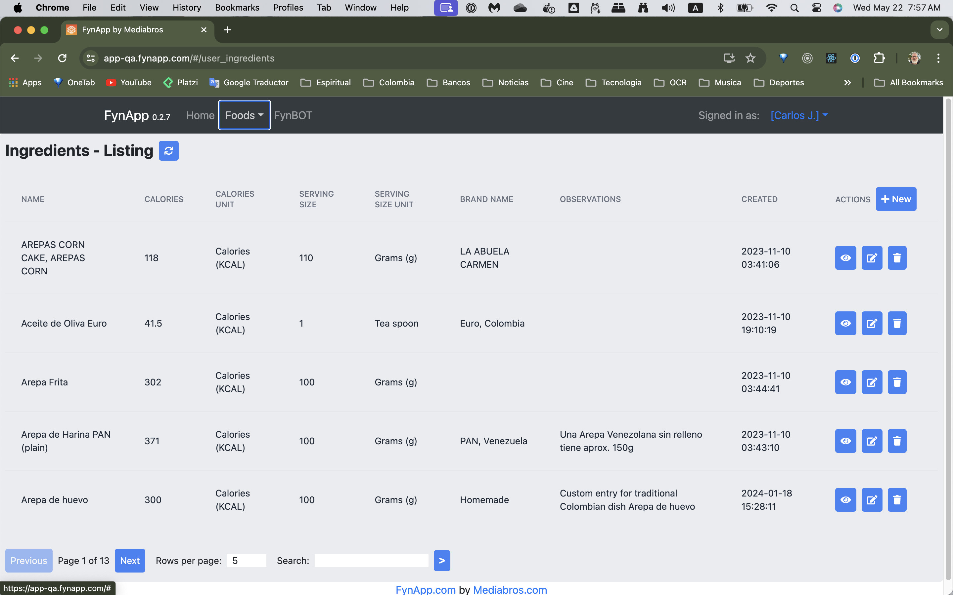
[ CRUD Editor – Ingredients (Index) ]

Slide 29
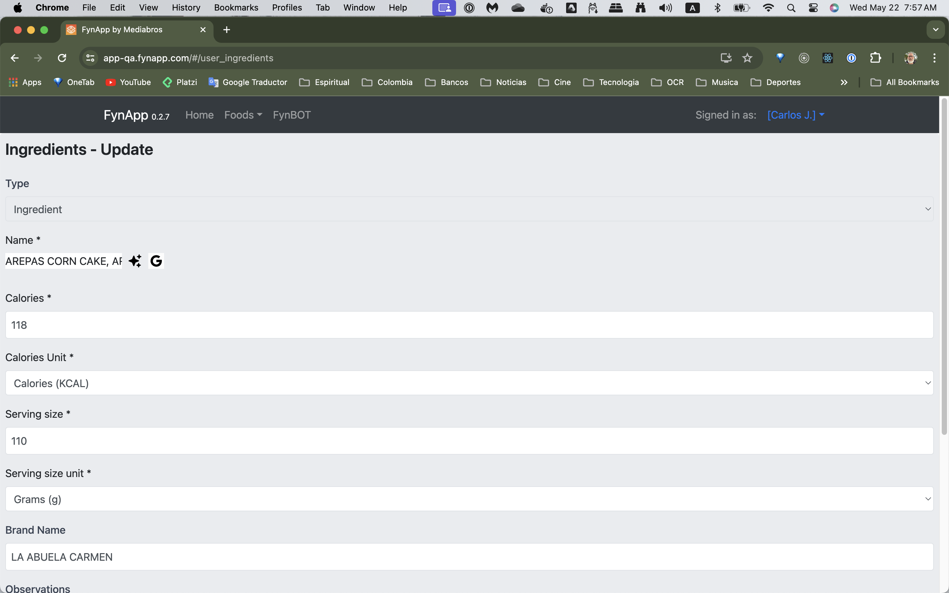
[CRUD Editor – Ingredients (Data Entry Form) ]

Slide 30
CRUD Editor – Ingredients
(Data Entry Form)

Slide 31
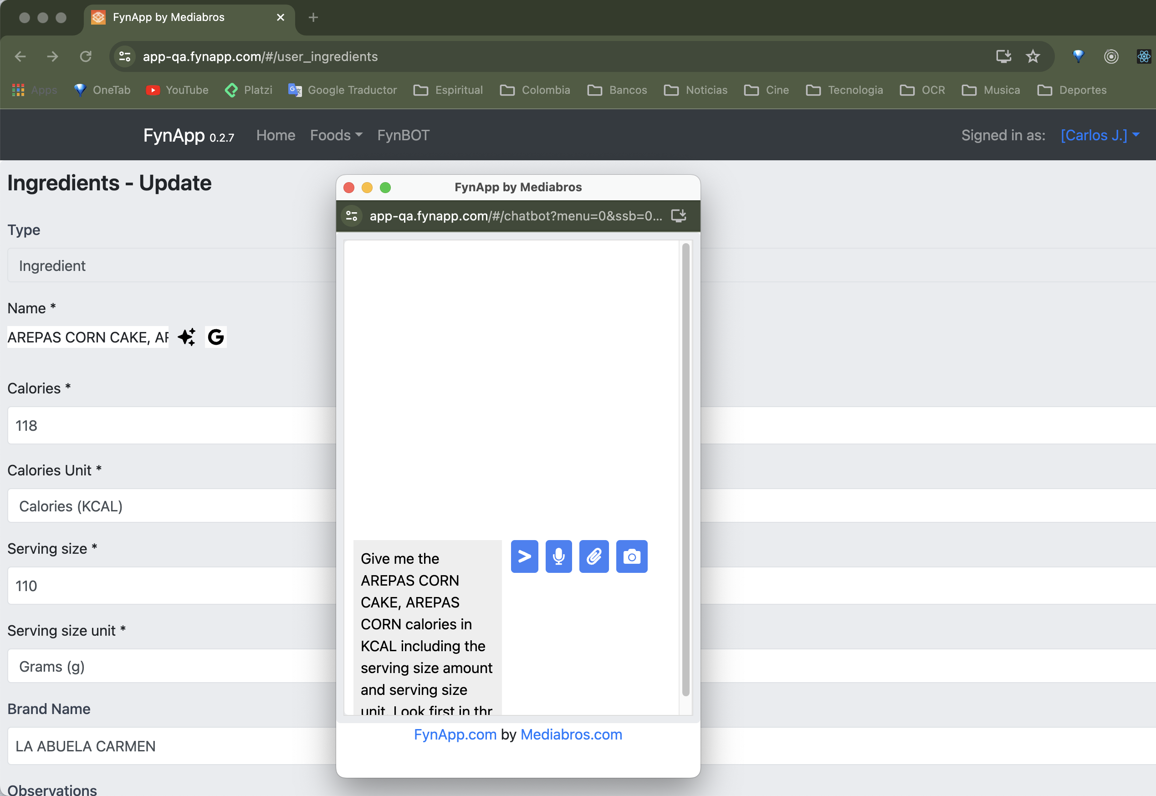
CRUD Editor – Ingredients
With AI Assistant pop-up window.

Slide 32
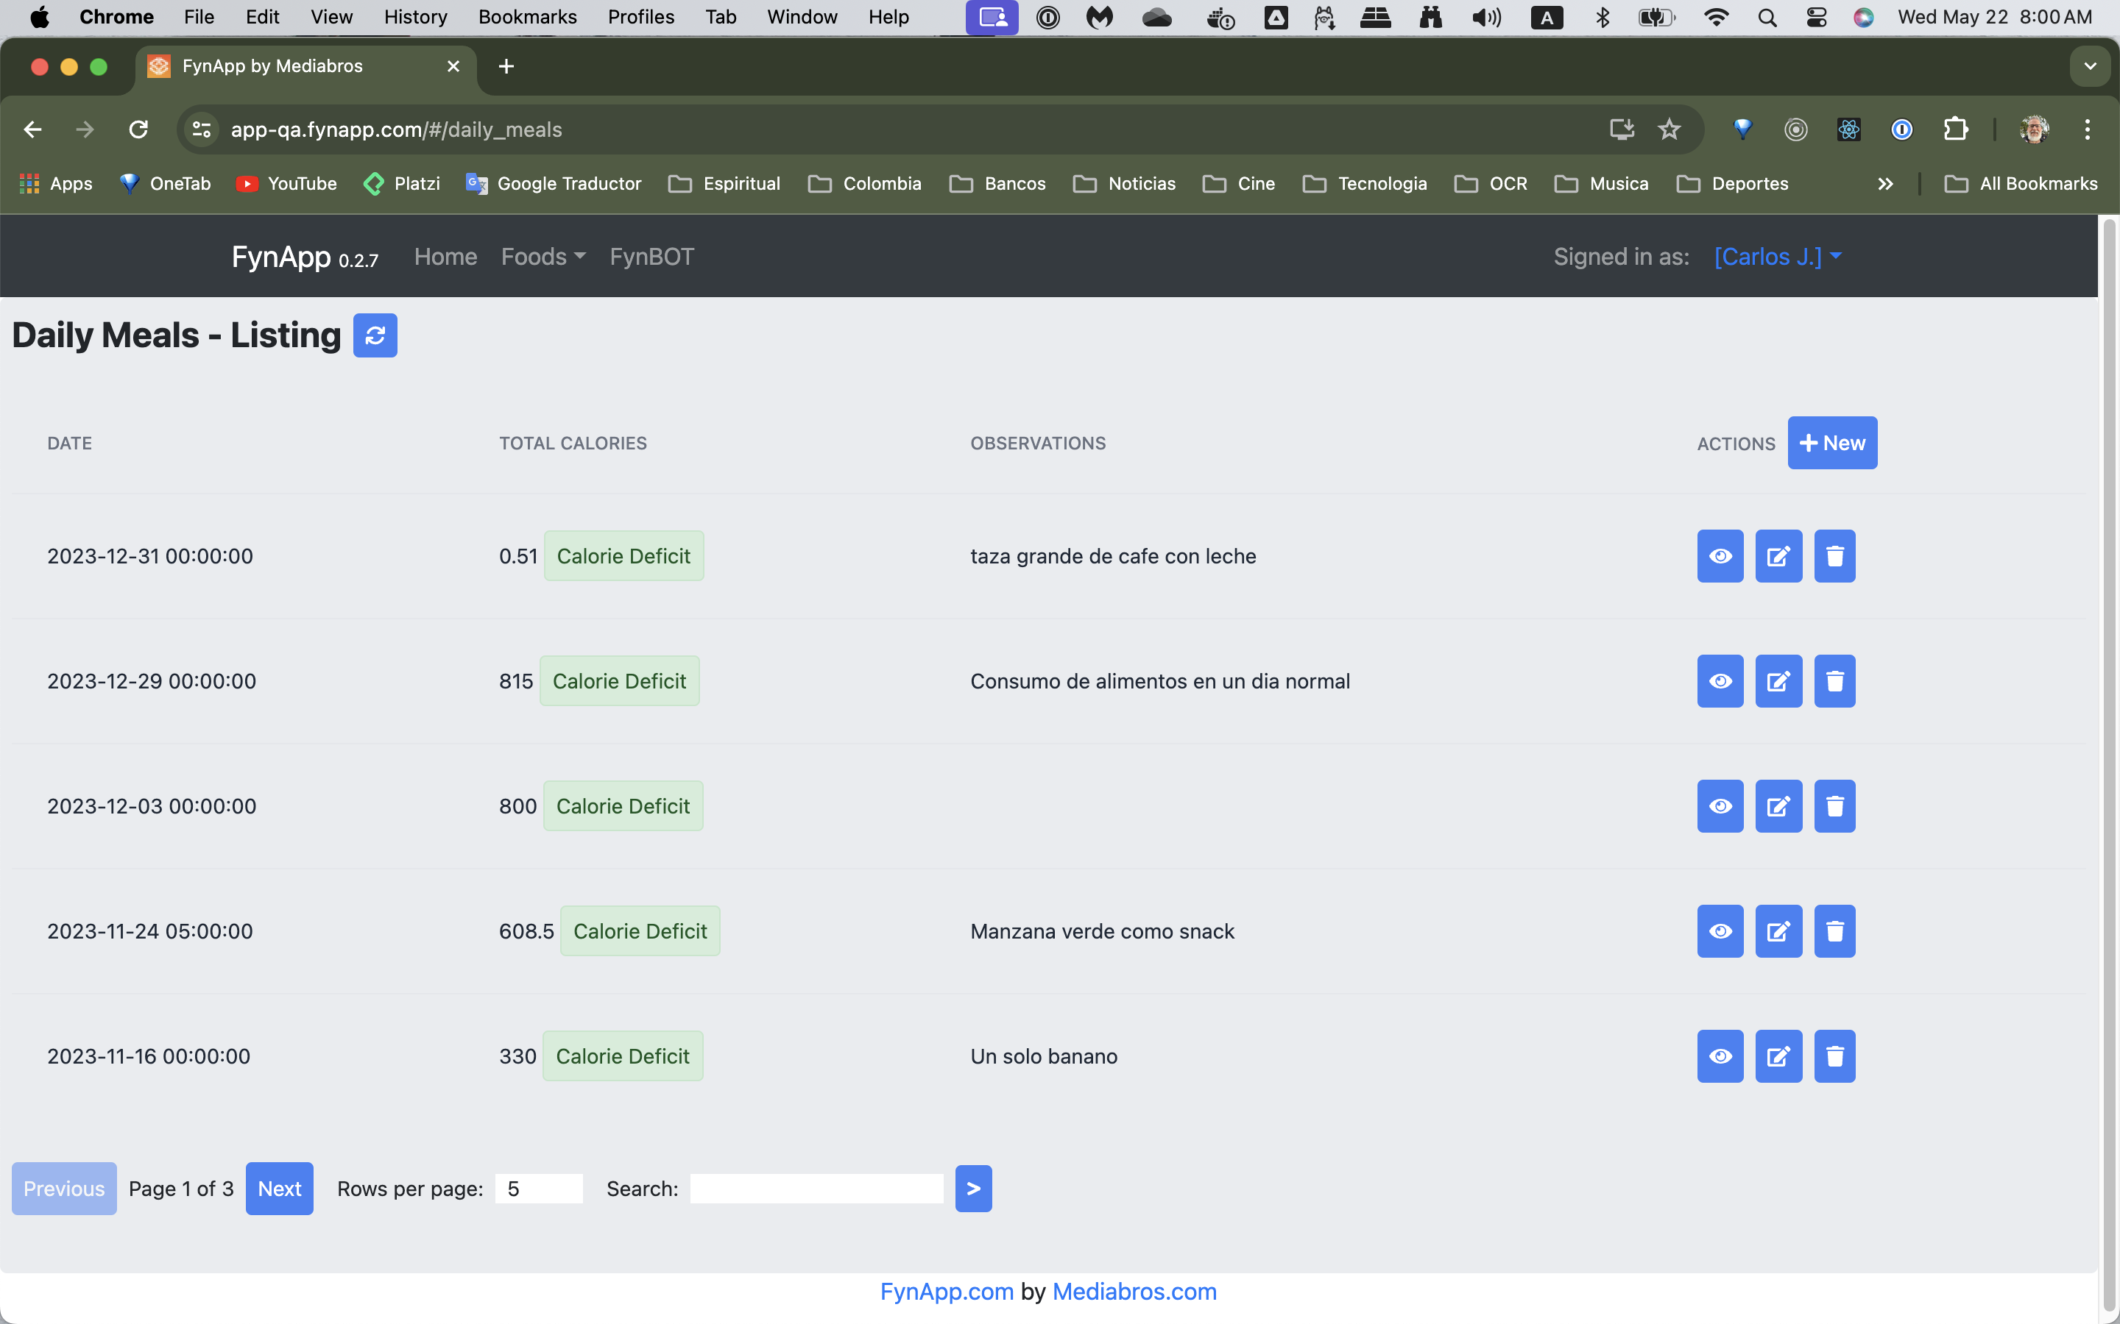
[ CRUD Editor - Daily Meals (Index) ]

Slide 33
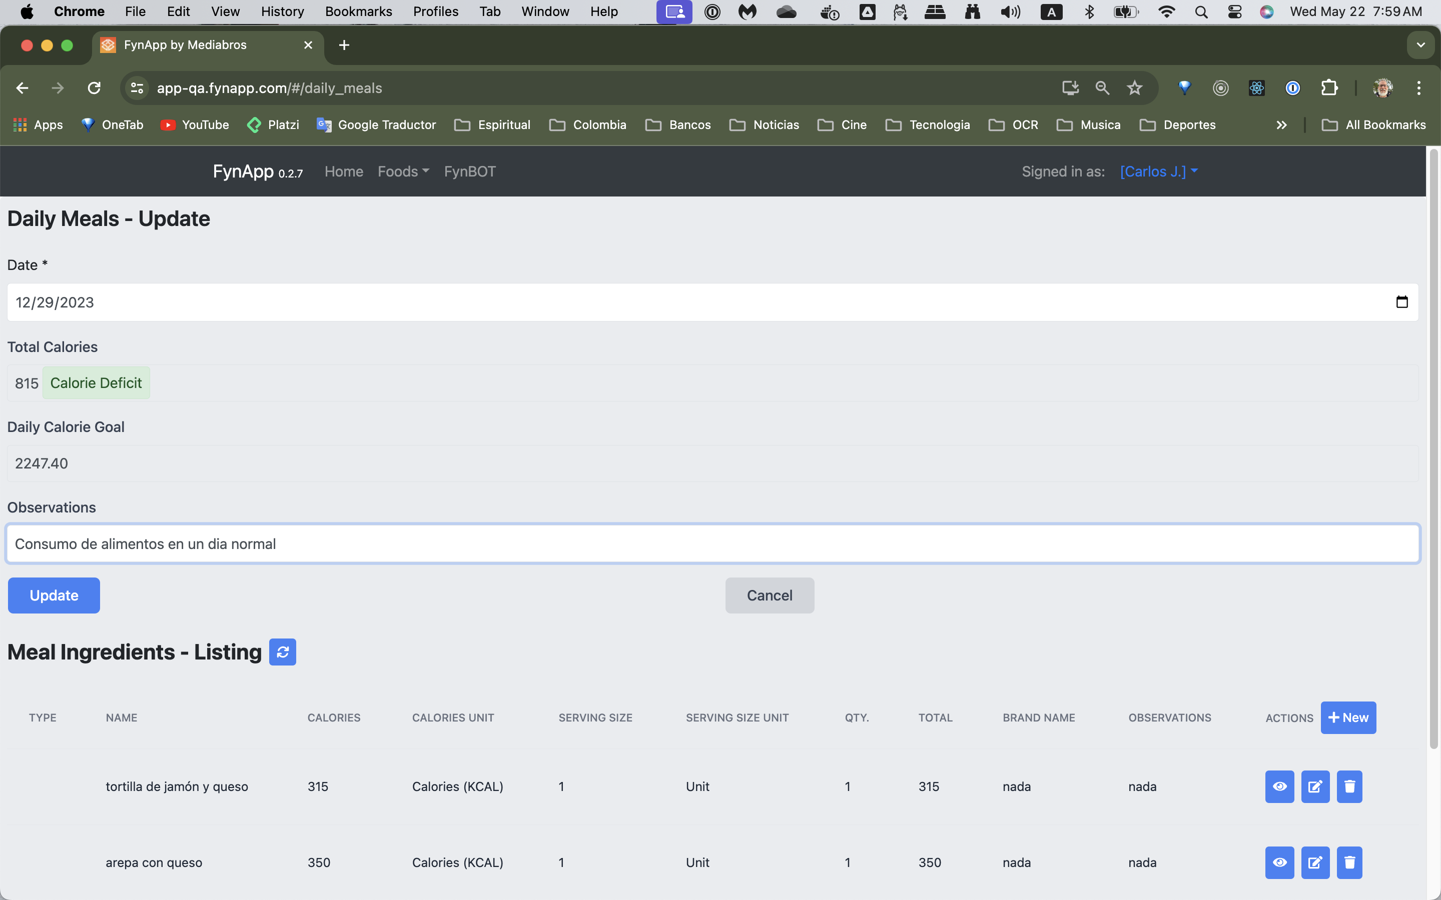
CRUD Editor - Daily Meals
Data Form with 1-N Relationship section

Slide 34
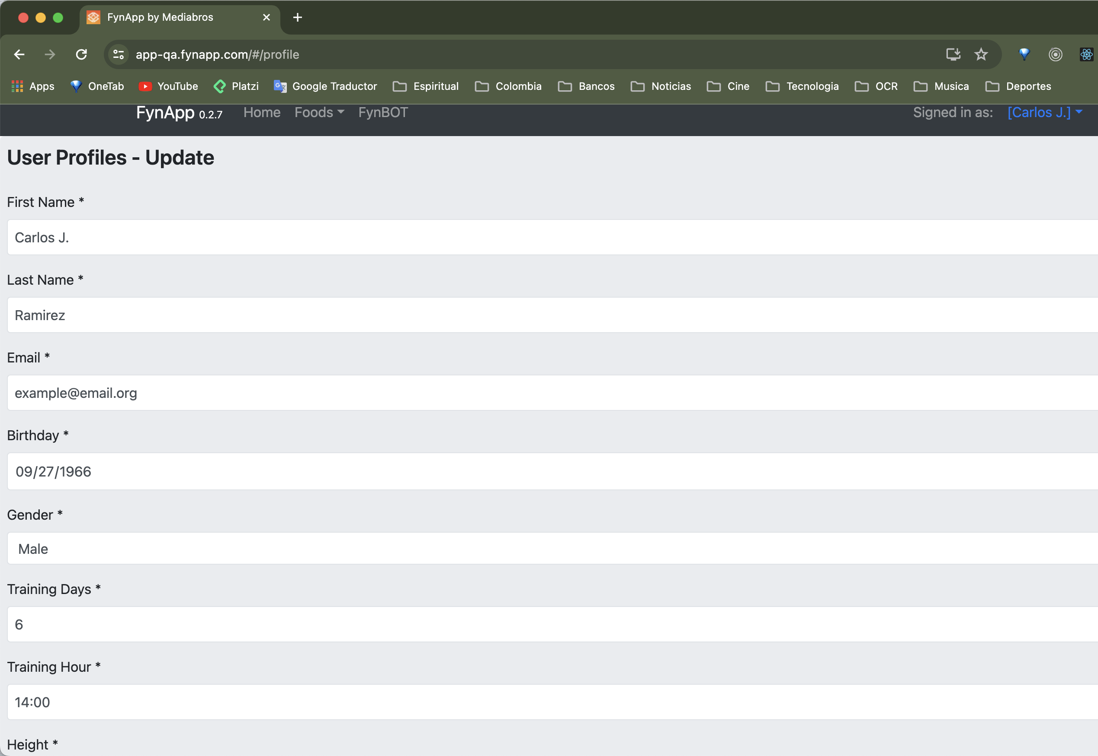
User Profile Editor
Single-record editor

Slide 35
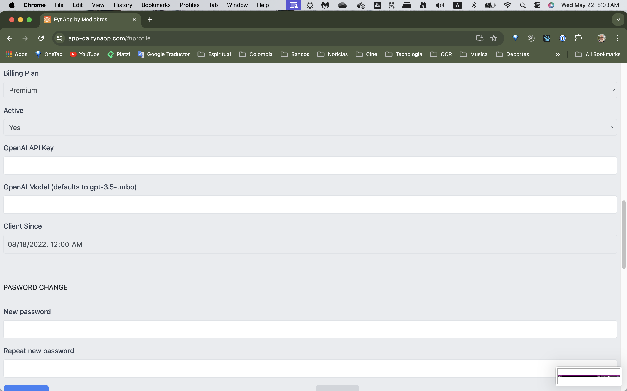
User Profile Editor
API Keys de IA.
Password Change.

Slide 36
Configuring Tables and CRUD Editor
{
"baseUrl": "users",
"title": "Users",
"name": "User",
"component": "Users",
"dbApiUrl": "users",
"fieldElements": [
{
"name": "id",
"required": true,
"label": "ID",
"type": "_id",
"readonly": true,
"hidden": false,
}, …
{
"name": "firstname",
"required": true,
"label": "First Name",
"type": "text",
"readonly": false,
"listing": true
},
{
"name": "lastname",
"required": true,
"label": "Last Name",
"type": "text",
"readonly": false,
"listing": true
}, …
{
"name": "status",
"required": true,
"label": "Active",
"type": "select",
"select_elements": "TRUE_FALSE",
"default_value": "1",
"listing": true
},
{
"name": "plan",
"label": "Billing Plan",
"type": "select",
"select_elements": "BILLING_PLANS",
"default_value": "1",
"listing": true
}, , …
{
"name": "update_date",
"label": "Last update",
"type": "datetime-local",
"readonly": true,
"default_value": "current_timestamp",
"listing": false
},
{
"name": "label0",
"type": "hr"
},
{
"name": "label1",
"label": "PASWORD CHANGE",
"type": "label"
},, …

Slide 37
Menu Configuration
[
{
"title": "Home",
"location": "top_menu",
"type": "nav_link",
"path": "/",
"element": "HomePage",
"hard_prefix": false,
"reload": true
}, …
{
"title": "Admin",
"location": "top_menu",
"type": "nav_dropdown",
"sec_group": "admin",
"sub_menu_options": [
{
"type": "editor",
"sec_group": "admin",
"title": "Users",
"element": "Users_EditorData”
}, …
]
}, …
{
"title": "AI Assistant",
"location": "top_menu",
"type": "nav_link",
"sec_group": "users",
"path": "/chatbot",
"element": "Chatbot"
}, …

Slide 38
API Endpoint Configuration
[
{
"name": "general_config",
"url_prefix": "general_config",
"routes": [
{
"endpoint": "/",
"methods": ["GET", "POST", "PUT", "DELETE"],
"handler_type": "GenericEndpointHelper",
"view_func": "lib.util.generic_endpoint_builder.generic_route_handler",
"params": {
"json_file": "general_config"
}
}
]
},
{
"name": "ai_chatbot_conversations",
"url_prefix": "ai_chatbot_conversations",
"routes": [
{
"endpoint": "/",
"methods": ["GET", "POST", "PUT", "DELETE"],
"handler_type": "GenericEndpointHelper",
"view_func": "lib.util.generic_endpoint_builder.generic_route_handler",
"params": {
"json_file": "ai_chatbot_conversations"
}
}
]
}

Slide 39
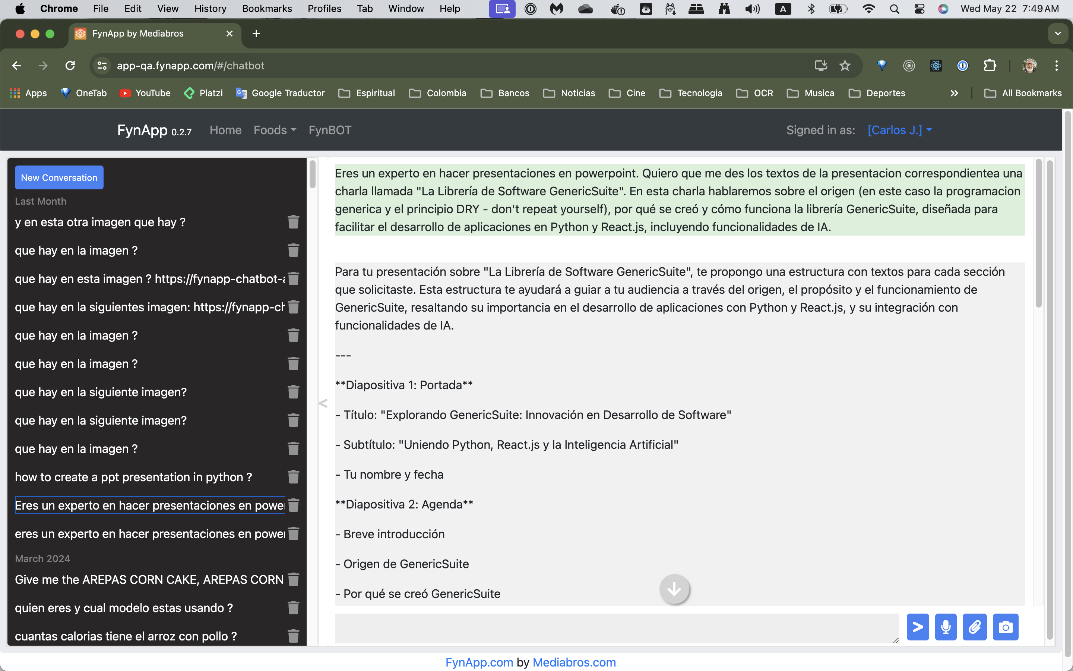
[ AI Assistant ]

Slide 40
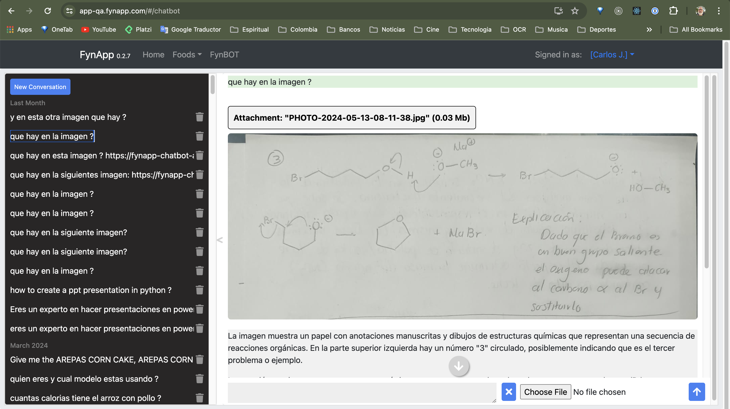
[ AI Assistant – Image Recognition ]

Slide 41
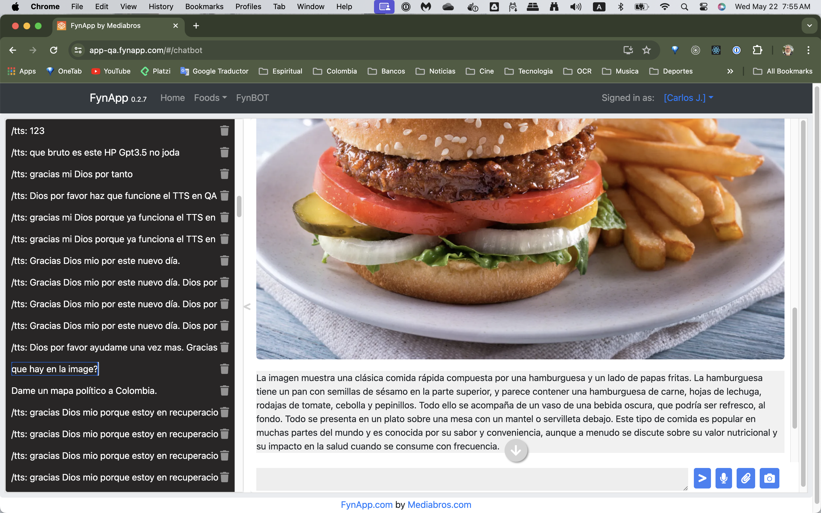
[ AI Assistant – Image Recognition ]

Slide 42
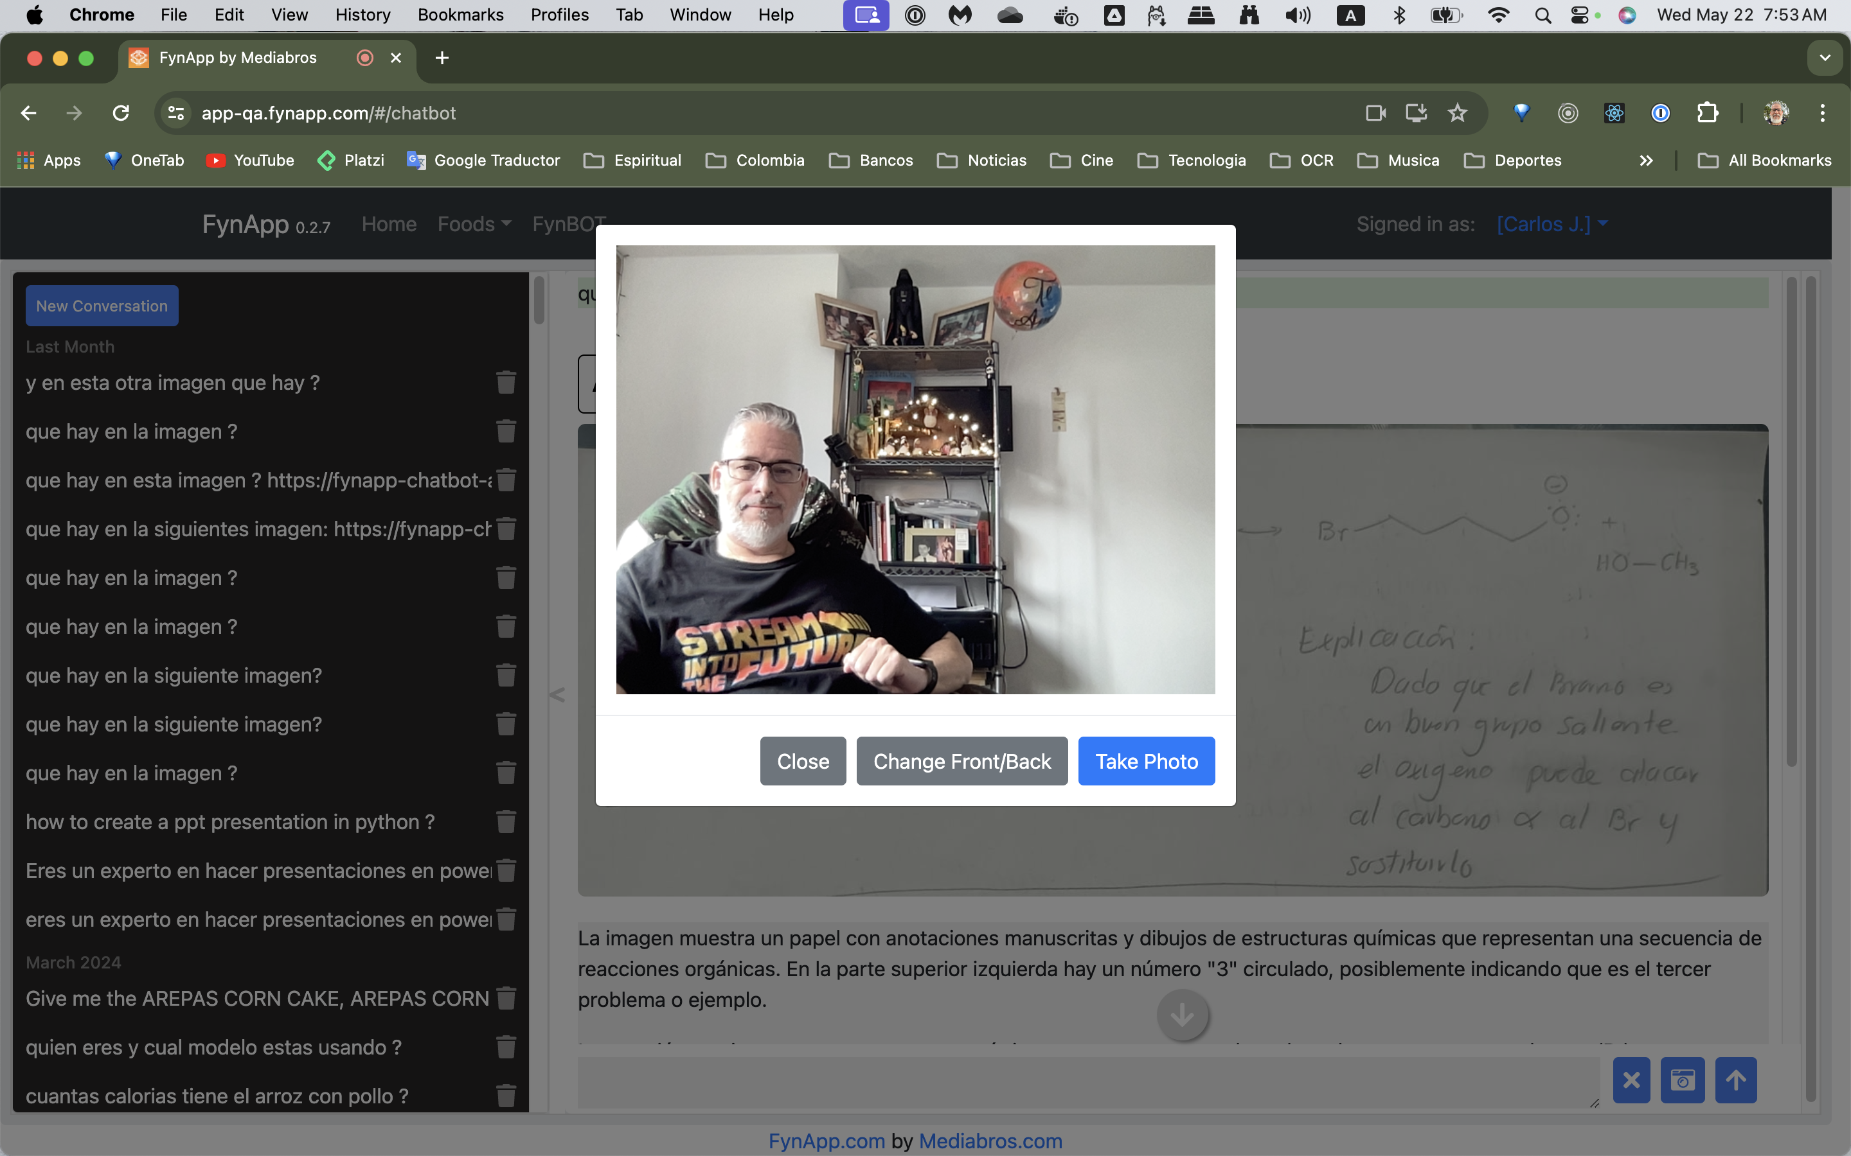
[ AI Assistant – Image Capture with Camera ]

Slide 43
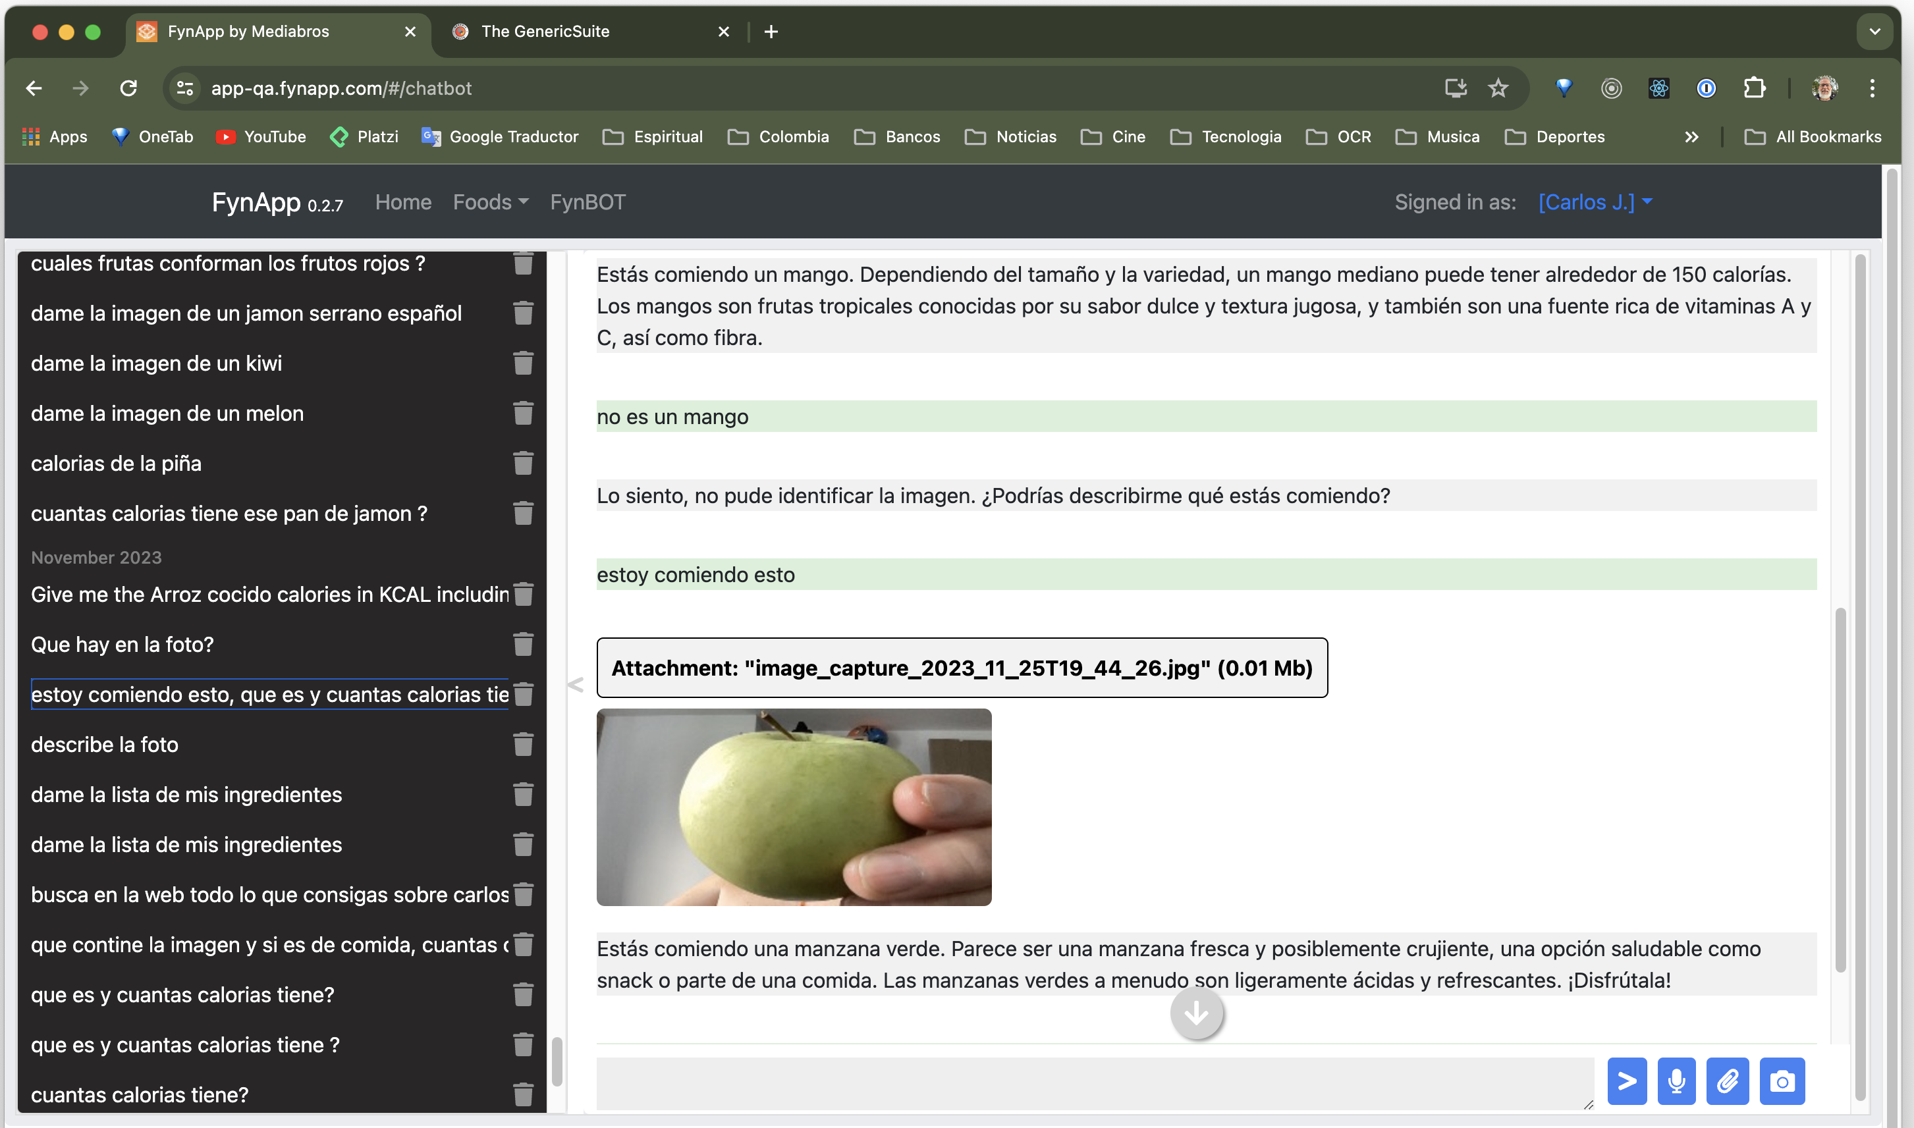
[ AI Assistant - Photo Shoot & Image Recognition ]

Slide 44
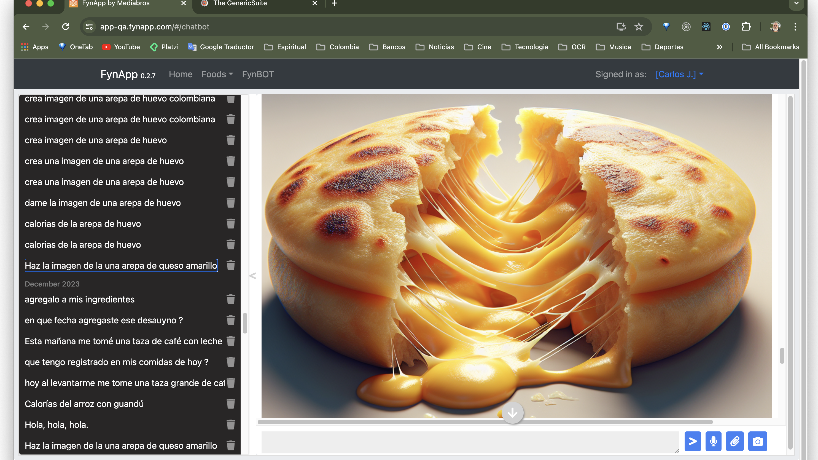
[AI Assistant - Image Generator ]

Slide 45
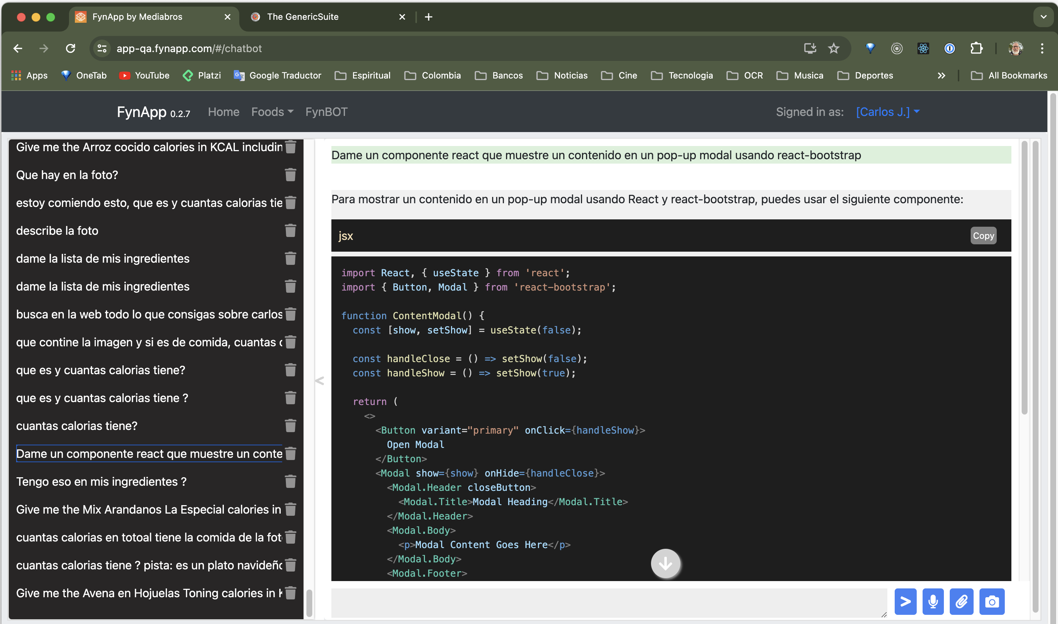
[ AI Assistant – Code Generator ]

Slide 46
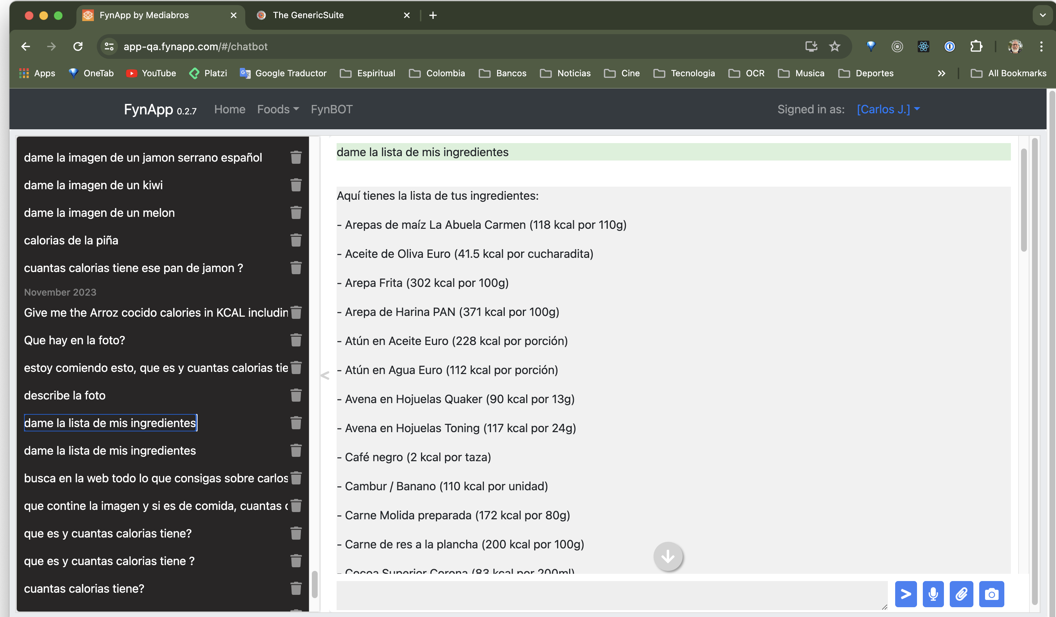
[ AI Assistant – RAG + GPT Functions ]

Slide 47
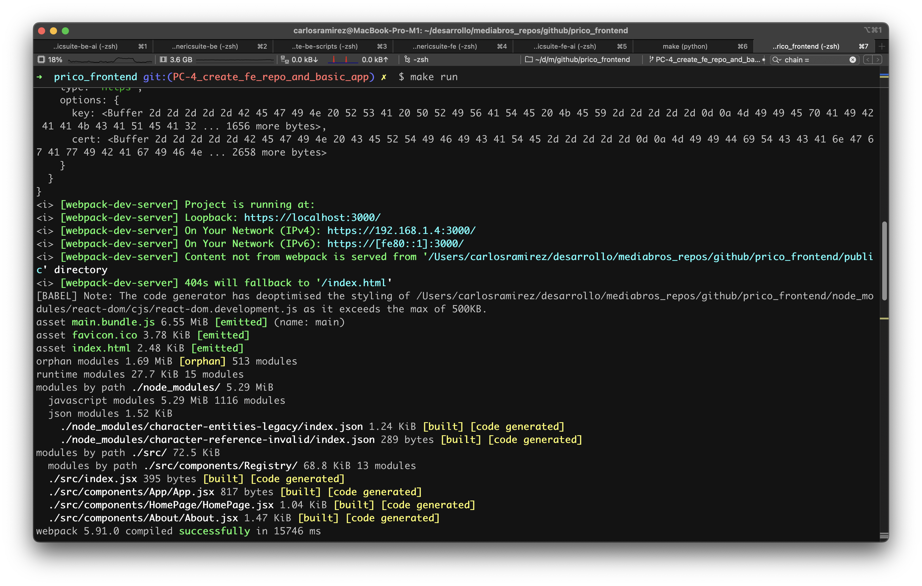
[ Running the Frontend in the local environment ]

Slide 48
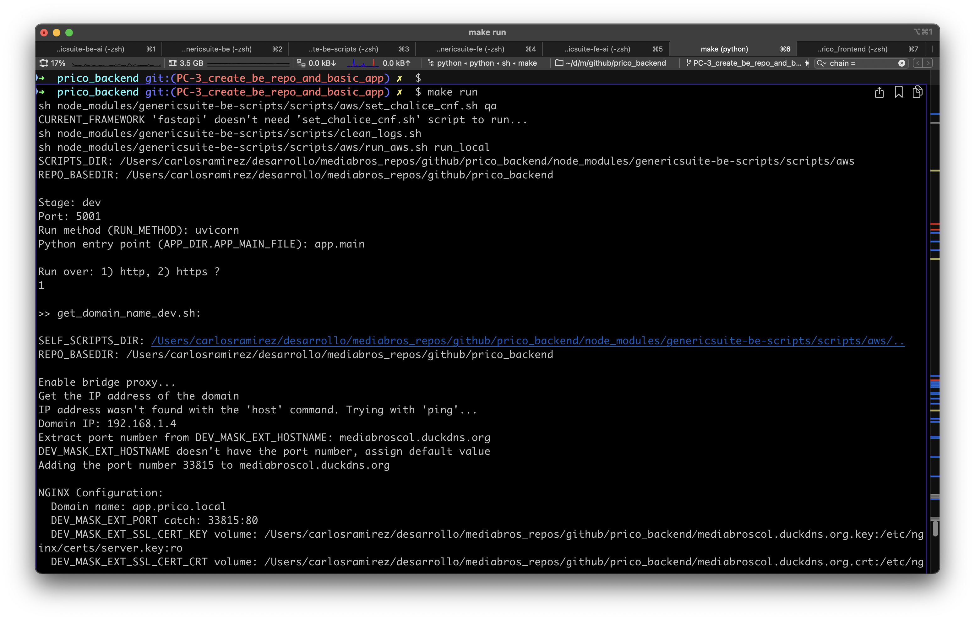
[ Running the Backend in the local environment ]

Slide 49
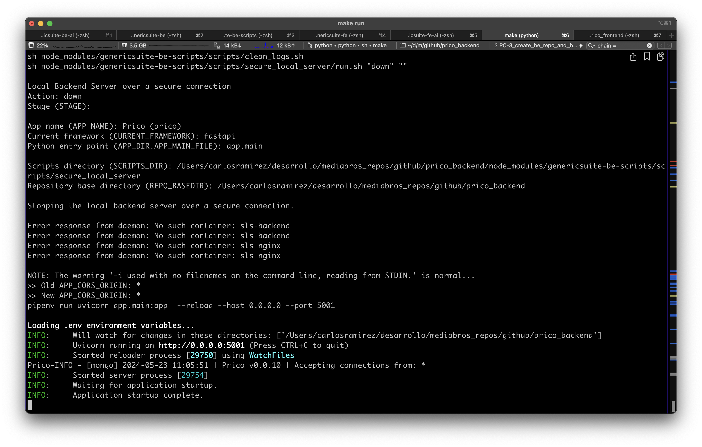
[ Running the Backend in the local environment ]

Slide 50
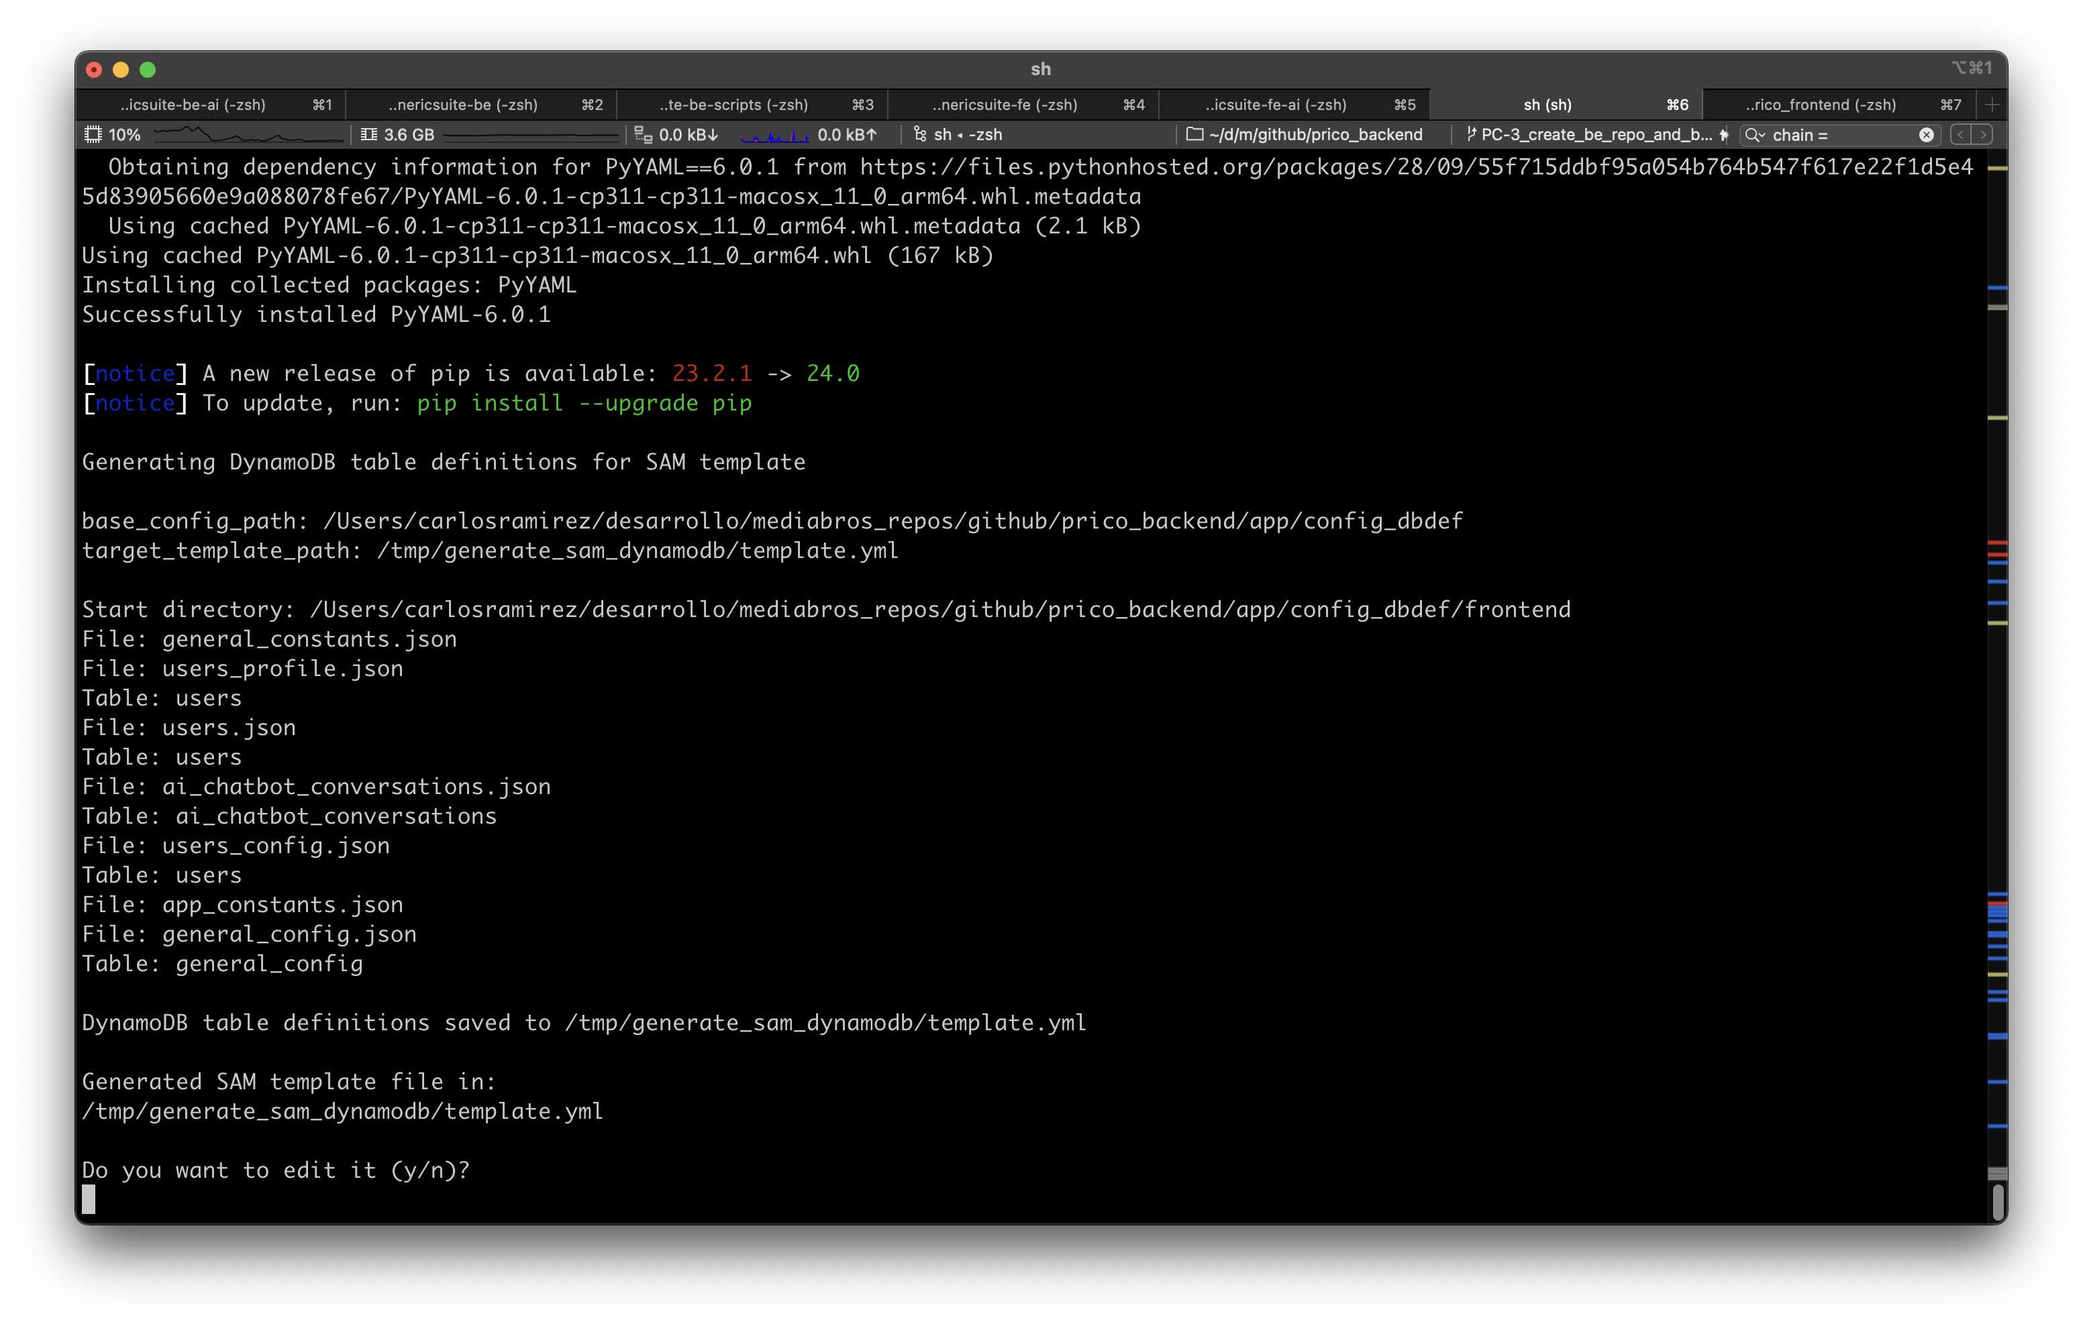
[ Generating the DynamoDB SAM definitions from the JSON config files ]

Slide 51
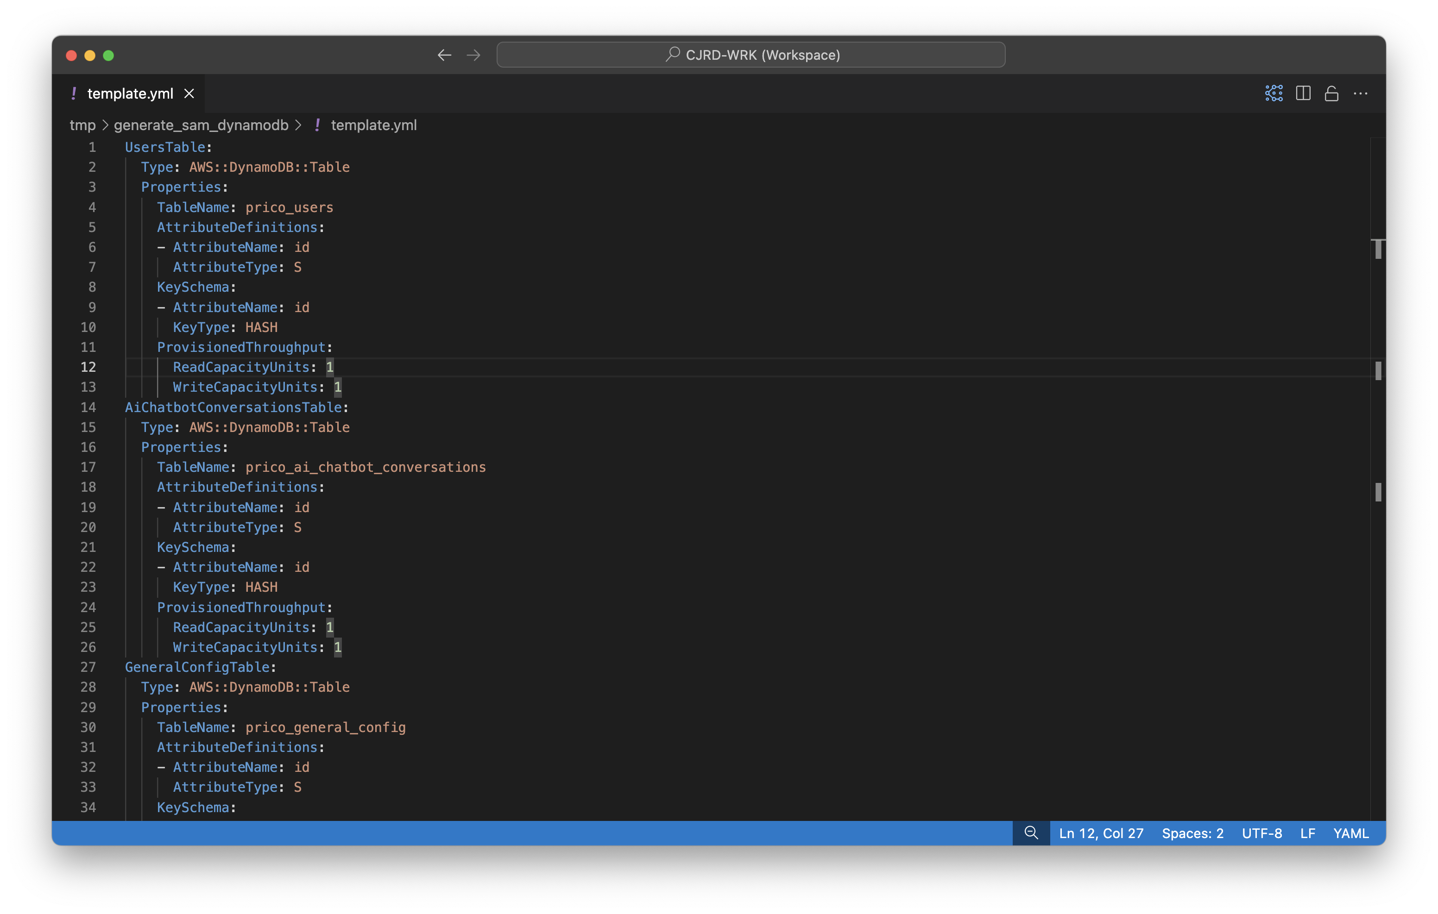
[ Generating the DynamoDB SAM definitions from the JSON config files ]

Slide 52

Tools Used
Github
AWS
MongoDB Atlas
ChatGPT, Claude, Bing Copilot
AmazonQ para VSC
Atlassian Jira
iTerm2
VSC, Cursor
Mkdocs, ReadTheDocs

Slide 53

Dedication
2 to 4 hours a day (without taking up hours of my formal job). Weekends, dedicating as many hours as possible. It took me a year and a half to develop the MVP. The journey continues...

Slide 54
Commitment
The Open-Source library development implies a great commitment with the Open-Source community, especially with bug fixes, dependency maintenance, frameworks and languages new versions, among many other things.
E.g. the imminent backdoor on a Linux key component, the XZ Utils Library. Its creator, Lasse Collin, doesn't have enough time to maintain the library and the attackers took advantage of this to orchestrate what could have been one of the most sophisticated cyberattacks in history.
https://www.securityweek.com/xz-utils-backdoor-attack-brings-another-similar-incident-to-light/

Slide 55

Conclusions
GenericSuite represents an evolution in my professional career.
It offers a solution that embraces the principles of generic programming and DRY.
Streamline processes in the software development cycle (SDLC).
It has allowed me to create powerful, flexible and cutting-edge applications in the short term.
Creating Open-Source libraries has been an incredible and empowering experience.
If you don't have the expertise in a language or technology you want to excel at, create your own project.
Stop being technology consumers. Let's become technology manufacturers.

Slide 56

Q&A
Could GenericSuite be applied in any of project of yours?
What functionalities would you like to explore further?

Slide 57
Contact
Carlos J. Ramírez
Web: www.carlosjramirez.com
LinkedIn: www.linkedin.com/in/carlosjramirez
Github: github.com/tomkat-cr
Documentation
genericsuite.carlosjramirez.com

